Slide 1


Slide 2


Slide 3
Visualize
R basics
Import
Tidy
Transform
Communicate
Stats
Data analysis workflow

Slide 4
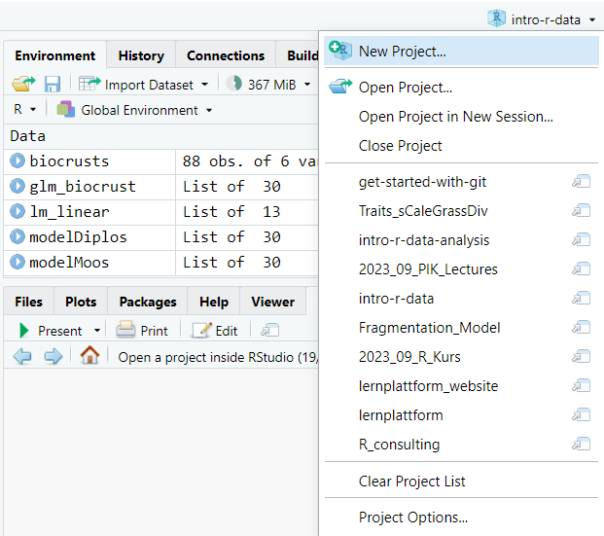

Slide 5
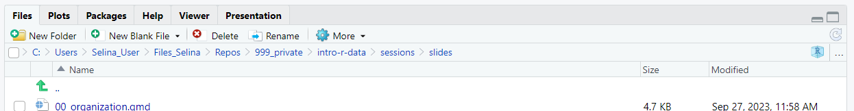
Project path
Go to project root
Open project in file explorer
Navigate one level up

Slide 6
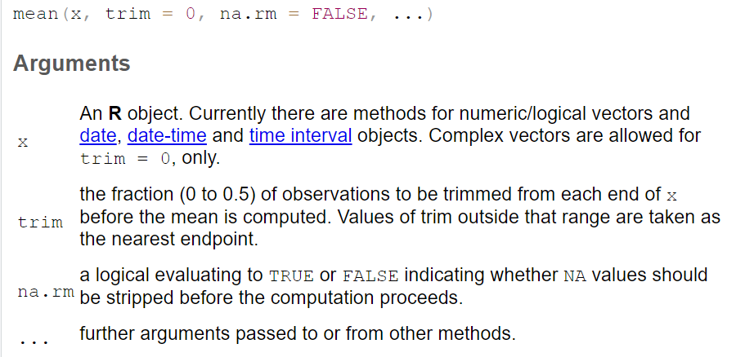

Slide 7
Function name
Input
Processing
Output
Side effects

Slide 8
mean
c(1, 5, 6)
Add values and divide by the length of the vector
4

Slide 9
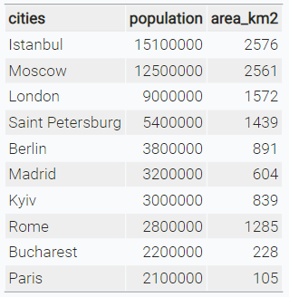
character
numeric

Slide 10





Visualize
R basics
Import
Tidy
Transform
Communicate
Model
Data analysis workflow

Slide 11

Data structure
Import
Tidy
Transform
Visualise

Slide 12
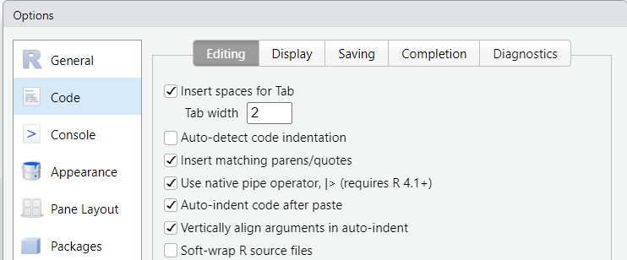

Slide 13
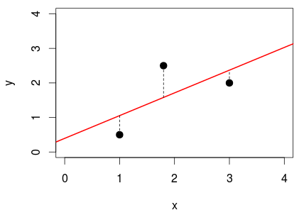

Slide 14
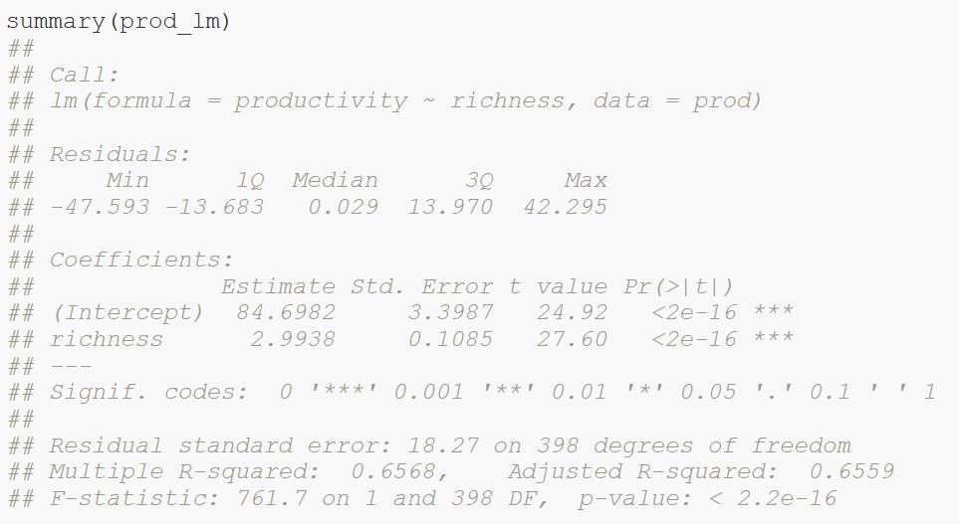
Calculated model
Distribution of residuals (errors)

Slide 15
Model coefficients:
Intercept = 84.7
Slope = 3
Standard error of coefficients

Slide 16
t-statistics: ratio of coefficients to their standard error

Slide 17
Coefficient of determination R²

Slide 18
F statistics: ratio of explained variance compared to null model

Slide 19
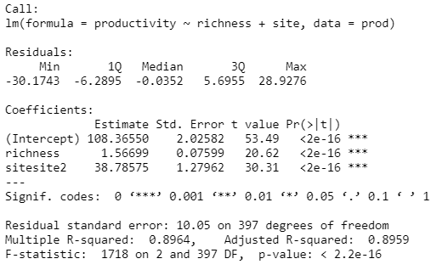
Intercept site1 = 108.4
Slope = 1.6
Intercept site2 = 108.4 + 38.8

Slide 20
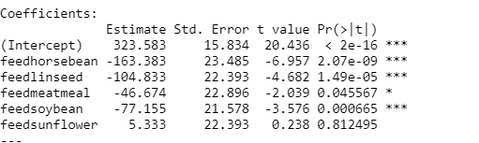
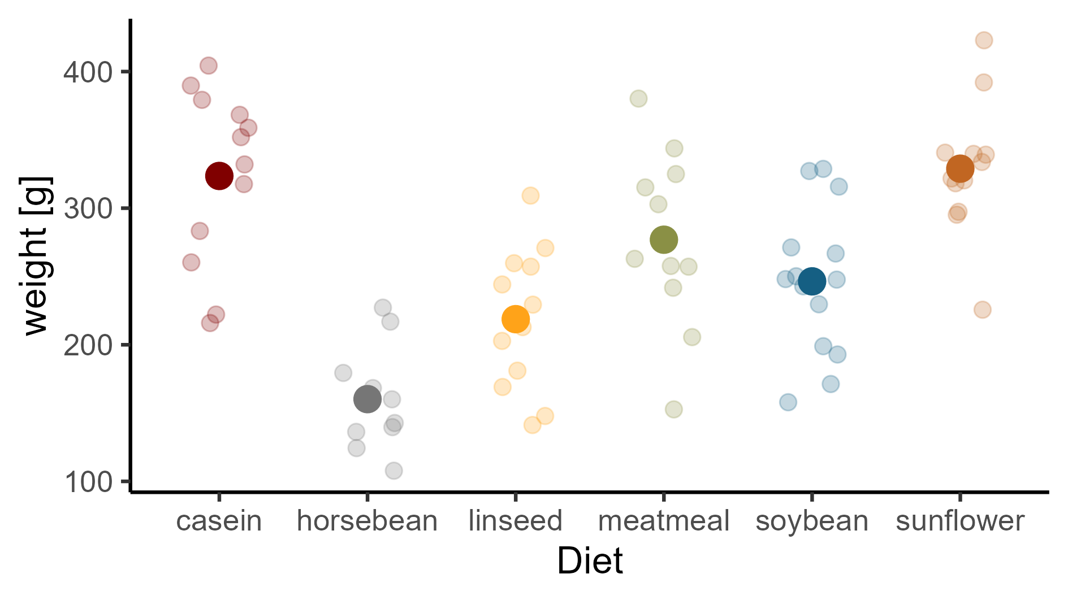

Slide 21
(Intercept) + feedlinseed
(Intercept) + feedsoybean
(Intercept)
(Intercept) + feedsunflower
(Intercept) + feedhorsebean
(Intercept) + feedmeatmeal

Slide 22
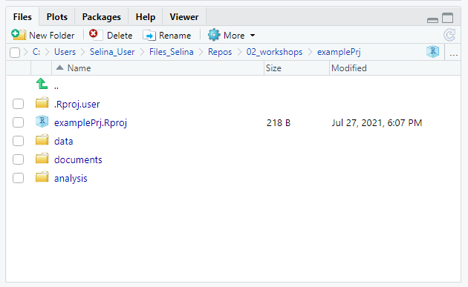
Navigate to project root
Project path
Navigate one level up
Open project in file explorer

Slide 23
Visualize
Import
Tidy
Transform
Communicate
Model
Understand

Slide 24
y
No interaction
y
Interaction
x₁
X₂
a
b
x₁

Slide 25




Slide 26
normal
distribution?
Kolmogorov-Smirnov-test, QQ-test, Shapiro-Wilk-test,..
yes
equal
variance?
F-test
no
yes
no
equal
mean?
t-test
Welch-
test
Wilcoxon-rank- sum-test
Note:
Levine-test not necessary, if you are interested
in equal means, but not equal variances!

Slide 27
Truth
H0 is true
H0 is false
Correct decision
Probability: 1 - α
Type II error
Probability: β
Accept H0
Decision based on statistical test
Type I error
Probability: α
Correct decision
Probability: 1 – β
(Power)
Reject H0

Slide 28


Scientific idea
working hypothesis H1
and
null hypothesis H0
p: how likely would it be to observe the data if the null hypothesis was true?
unlikely (p ≤ α):
reject H0
otherwise: not not reject H0
collect data
chose level of
significance α,
test the null
hypothesis
errors possible

Slide 29
A
B
joined and sorted

Slide 30
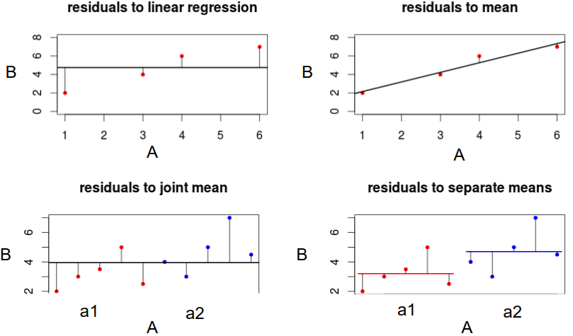
Residuals to mean
Residuals to regression line
Residuals to joint mean
Residuals to separate means

